Slide 1
New Developments at ICPSR for Improving Replication and Evaluation
Jared Lyle
“Technical Solutions to Advance Evaluation and Replication in the Social Sciences: What’s New, What's Next” Data-PASS workshop
August 2, 2018
The initiatives described here are supported by the National Science Foundation (1744065) and the Sloan Foundation.
Notes:
This presentation will report on three recent activities at ICPSR to improve replication and evaluation in the social sciences. The first activity is facilitating and opening access to restricted-use data. The second activity is improving discovery of data-related publications. The third activity is building communities around archived data by enabling users to comment and contribute.

Slide 2
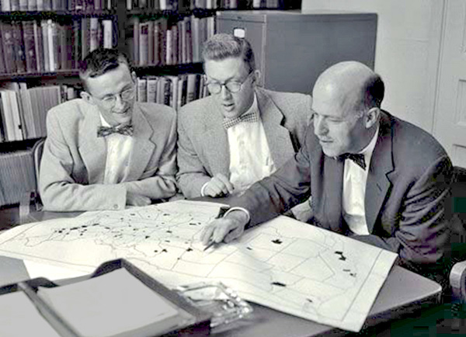
ICPSR
Established 1962
Originally 22 Members, now consortium of 776 world-wide
Originally Political Science, now all social and behavioral sciences
Philip Converse, Warren Miller, and Angus Campbell
Source: http://www.icpsr.umich.edu/icpsrweb/content/membership/history/timeline.html
Notes:
The Inter-university Consortium for Political Research (ICPR, as it was first known) was created in 1962 by political scientist Warren E. Miller as the data dissemination arm of the American National Election Studies (ANES^{i}).
In hindsight, we can think of this data sharing motive as a prerequisite of the "scientific ethic" of verification, replication, and validation. In the early 1960s, though, the concept of giving access to all interested scholars to one's basic (micro) data was so foreign as to be considered "revolutionary." Miller even likened it, in retrospect, to a violation of basic economic precepts: data were the scientist's capital, and "they weren't about to share their capital."^{ii}
https://www.icpsr.umich.edu/icpsrweb/content/about/history/early-years.html

Slide 3
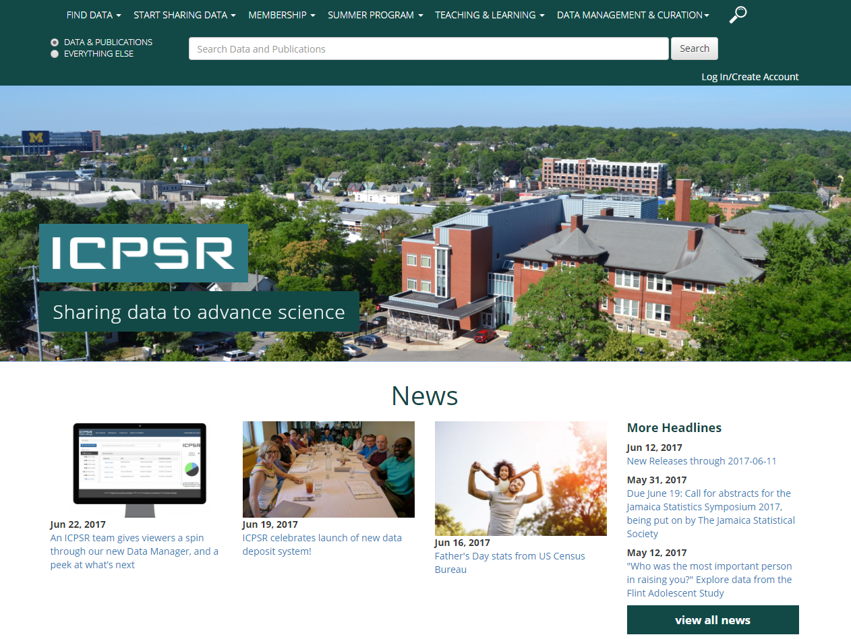
http://www.icpsr.umich.edu

Slide 4
ICPSR
Current holdings
10,000+ studies, quarter million files
1,500+ are restricted studies, almost always to protect confidentiality
Approximately 60,000 active MyData (“shopping cart”) accounts
Thematic collections of data about addiction and HIV, aging, arts and culture, child care and early education, criminal justice, demography, health and medical care, and minorities

Slide 5
ICPSR
Make data sharing feasible
ICPSR’s General Archive
Anyone can deposit
Curated and preserved
Guidance over data life cycle
Templates for consent, IRB, DMP consistent with transparent and reproducible access
Incentivize data sharing
Standard citation
Bibliography
Usage statistics

Slide 6
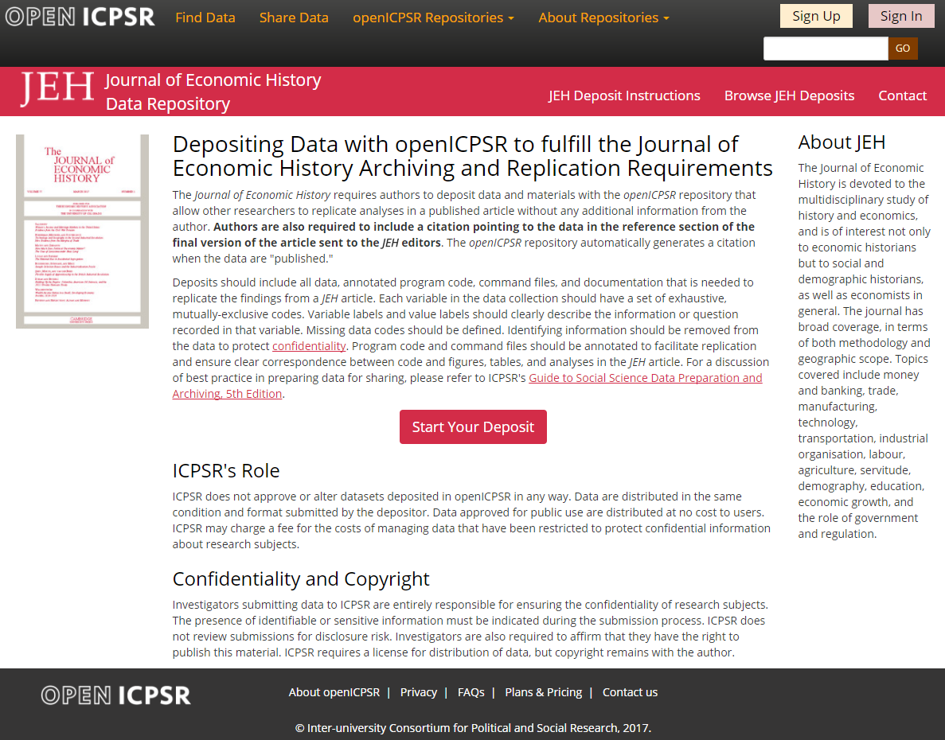

Slide 7
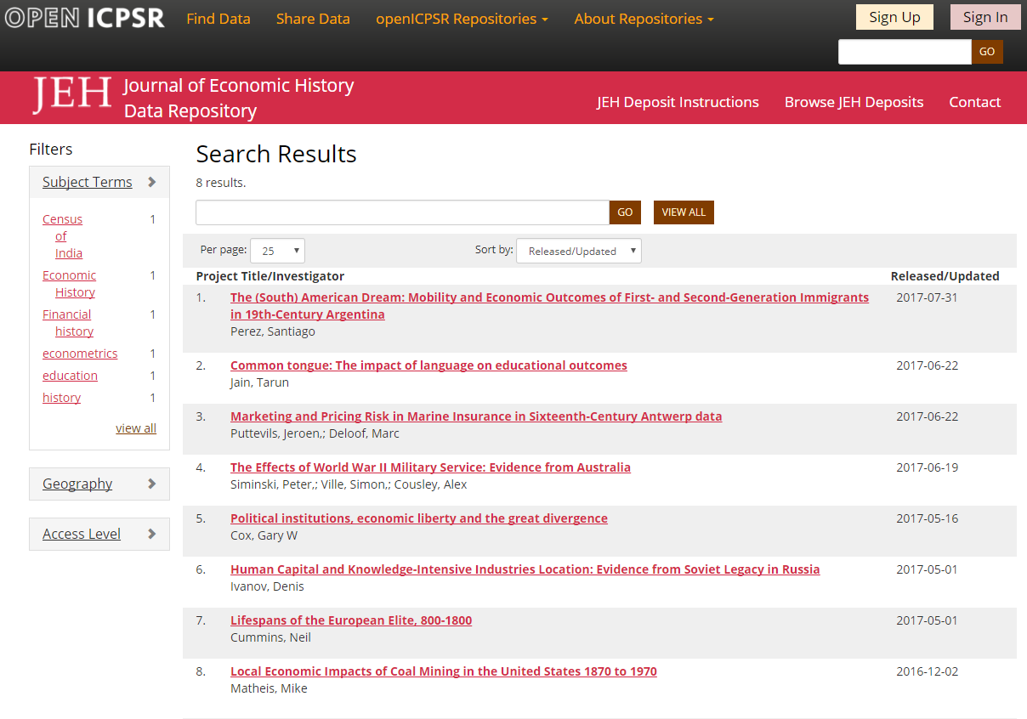

Slide 8
Improving Replication and Evaluation:
Data-Related Literature
Restricted-Use Data
Building Communities

Slide 9
Data-Related Literature
Notes:
The Bibliography now references nearly 70,000 works, including journal articles, books, working papers, dissertations, and newspaper articles.

Slide 10
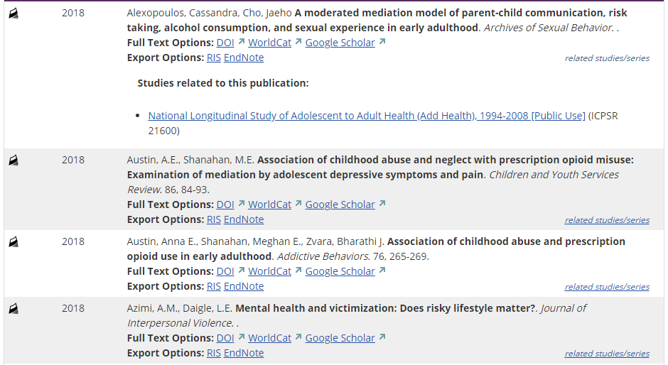
Harris, Kathleen Mullan, and Udry, J. Richard. National Longitudinal Study of Adolescent to Adult Health (Add Health), 1994-2008 [Public Use]. Ann Arbor, MI: Carolina Population Center, University of North Carolina-Chapel Hill [distributor], Inter-university Consortium for Political and Social Research [distributor], 2018-08-06. https://doi.org/10.3886/ICPSR21600.v21
Notes:
The Bibliography now references over 75,000 works, including journal articles, books, working papers, dissertations, and newspaper articles.

Slide 11
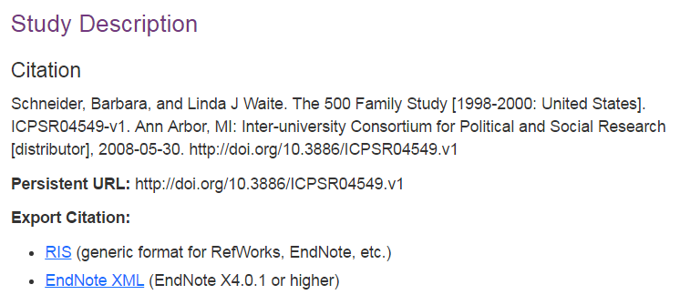
ICPSR has provided data citations since 1990, and assigned digital object identifiers (DOIs) since 2008.
Notes:
Required fields:
Content Creator/Principal Investigator
Title
Distributor [Optional]
Date
Persistent Identifier – like Digital Object Identifier (DOI)
Citations may include more information and may be supported by additional metadata.

Slide 12
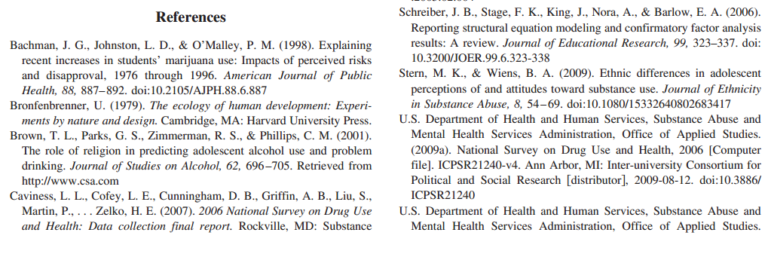
doi:10.3886/ICPSR21240

Slide 13
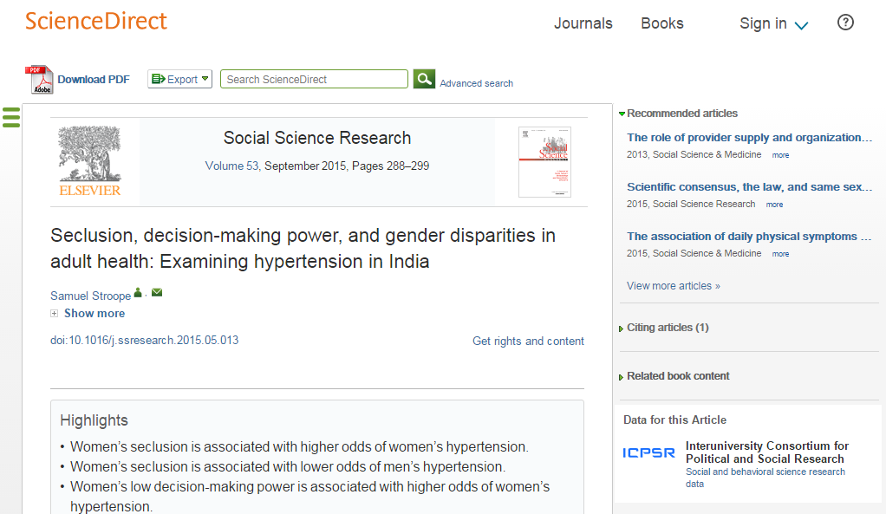
Notes:
Benefits:
-Reinforces good practice – linking publications and data, data citation, metadata, access
-Brings greater visibility for data resources and data producers
-Highlights DOIs for data prominently
-Broadens resource discovery across disciplines
-Shows impact of investment in data to funders

Slide 14
Data citation allows us to answer:
Who uses the data?
How are they used?
With what impact?

Slide 15
J Kratz and C Strasser. 2015. Making data count. Nature Scientific Data 2: 150039. dx.doi.org/10.1038/sdata.2015.39
Citations: Citations are the coin of the academic realm. They were by far the most interesting metric to both researchers and data managers. Unfortunately, citations are much more difficult than download counts to work with, and relatively few repositories track them. Beyond technical complexity, the biggest challenge is cultural: data citation practices are inconsistent at best, and formal data citation is rare. Despite the difficulty, the value of citations is too high to ignore, even in the short term.
https://datapub.cdlib.org/2015/08/04/2334/

Slide 16
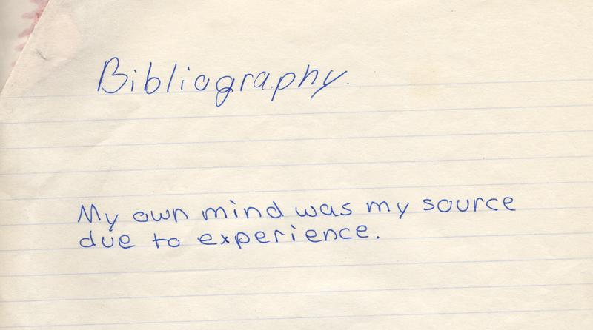
http://www.flickr.com/photos/papertrix/38028138/
(CC BY-NC 2.0)
Notes:
Have provided data citations since 1990, DOIs since 2008
With DataPASS partners, ICPSR contacted major journals in sociology, economics, political science
Highlighted past data citation practices
Emphasized use of citations, persistent identifiers
ASR revised its Submission Guidelines to reflect data citation requirement

Slide 17
Challenges of Data Citation
Poor and inconsistent citing practices
Ambiguous descriptions of data used in abstract, methodology, acknowledgments
Requires inefficient (human) searching and browsing to track data and keep up with the demand
Without standard practice, it is very difficult to quantify the impact of data sharing
Notes:
From its experience building and growing the Bibliography over the last decade it became obvious that there is no norm for citing data, and no commonly used standards for doing so. Though there are standard practices for citing legal cases, laws, and journal articles. If data are acknowledged, they rarely appear in a publication’s reference section or bibliography, making it difficult to detect it in a simple, efficient way. Authors, whether they are the data creators, or secondary users, often do not mention the study title, let alone cite the assigned citation or DOI. One of the defacto outcomes of this practice is that it requires the reader to infer what data were used. Much human “text mining” effort must therefore go into determining if data were used and if so, how to identify it in order to create access to it. The effect is that data producers are not always receiving proper credit, and much data are effectively hidden from those who would replicate analyses or reuse data. An environment with no standard way of citing research data and no established publishing infrastructure to optimize good discovery and attribution means data producers and users lose. Discovery=reward.

Slide 18
Examples of poor citation practice
Sample described, not named, no author information, no access information, only a publication cited
Data named in text, with some attribution, but no access information
Cited in reference section, but with no permanent, unique identifier, so difficult for indexing scripts to find to automate tracking

Slide 19
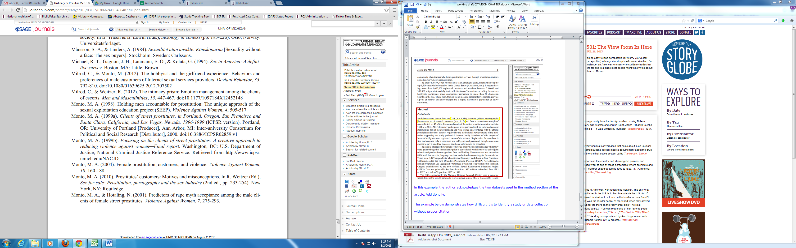
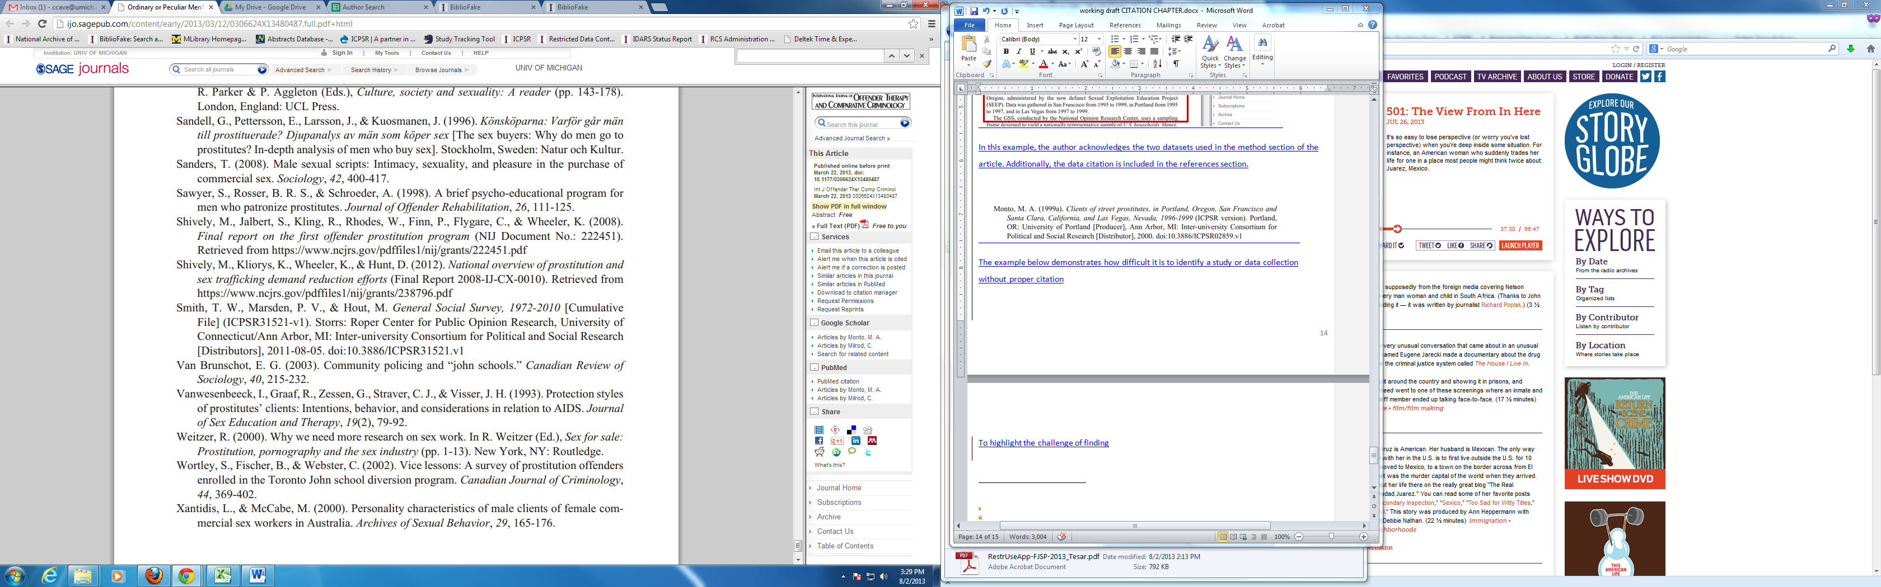
Examples of a good data citation
Citing data with a DOI
+
Minimal human search effort
=
High hit accuracy for the cost, and better confidence of impact measures
Version of the data file
ICPSR unique DOI
ICPSR Study Number
Notes:
Monto, Martin A. Clients of Street Prostitutes in Portland, Oregon, San Francisco and Santa Clara, California, and Las Vegas, Nevada, 1996-1999. ICPSR02859-v1. Ann Arbor, MI: Inter-university Consortium for Political and Social Research [distributor], 2000. http://doi.org/10.3886/ICPSR02859.v1

Slide 20
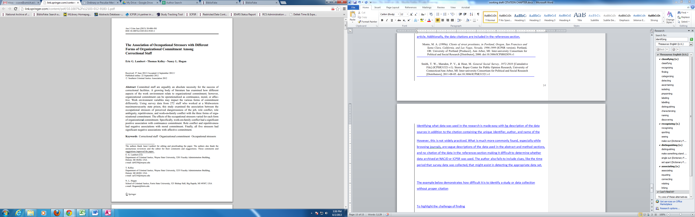
Examples of a poor data citation
Poorly described and cited data
+
Excessive human search effort, extensive collection knowledge
=
Too costly, too questionable for confident measure of impact
Notes:
Monto, Martin A. Clients of Street Prostitutes in Portland, Oregon, San Francisco and Santa Clara, California, and Las Vegas, Nevada, 1996-1999. ICPSR02859-v1. Ann Arbor, MI: Inter-university Consortium for Political and Social Research [distributor], 2000. http://doi.org/10.3886/ICPSR02859.v1

Slide 22
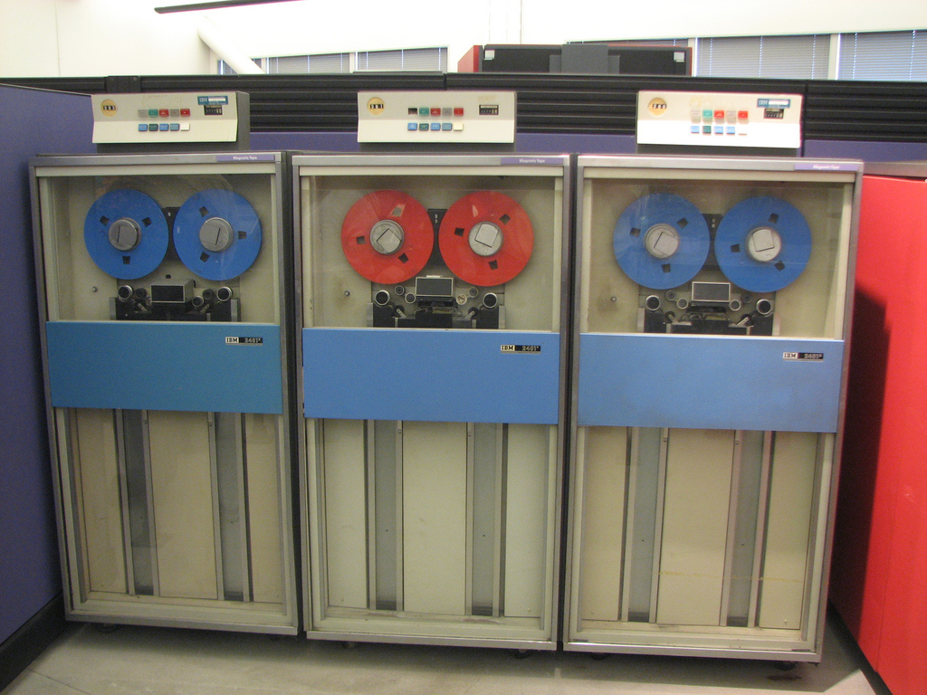

Slide 23
Automating the discovery of research datasets in publications

Slide 24
Rich Context Competition
Sponsors:
New York University’s Coleridge Initiative
Inter-university Consortium for Political and Social Research (ICPSR)
Funding provided by: the Schmidt Family Foundation, Overdeck Family Foundation, and Alfred P. Sloan Foundation
Data provided by: Digital Science and SAGE Publications

Slide 25
Phase 1: Provided labeled data, consisting of a corpus of 2,500 publications matched to the datasets cited within them. You can use this data to train and tune your algorithms. A separate corpus of 2,500 publications will be the test corpus, which we will run ourselves on our servers with your submissions; you can validate your algorithm up to 5 times.
Notes:
https://coleridgeinitiative.org/richcontextcompetition
Algorithms will be evaluated for accuracy, run-time, usability, and novelty.

Slide 26
Phase 2: Provided with a large corpus of unlabeled documents and asked to identify the datasets used in the documents in the test data set, as well as the associated methods and research fields.
All submitted algorithms will be made publicly available as open source tools.

Slide 28
Restricted-Use Data
Notes:
The Bibliography now references nearly 70,000 works, including journal articles, books, working papers, dissertations, and newspaper articles.

Slide 29
Restricted-Use Holdings at ICPSR
Over 1,500 restricted-use datasets available for analysis
Approximately 20 datasets accessible only on site in physical enclave
Over 2,000 active restricted-use data agreements
Across 500+ institutions
Representing 150+ studies
Approximately 50 new agreements executed per month

Slide 30
Methods of Accessing Restricted-Use Data
ICPSR offers three methods of restricted-use data access:
Physical Enclave
Secure Dissemination
Virtual Data Enclave (VDE)
Notes:
We also use SSDA, in which researchers cannot directly access data, but can submit jobs and receive output that is automatically checked for disclosure risk.

Slide 31
Physical Enclave
Researcher must be present in person at ICPSR to analyze data
All results reviewed for disclosure before release to researcher
Allows greatest control over data
Extremely high barrier to access

Slide 32

Secure Dissemination
Data are encrypted and delivered via download
On-line proposal request system
When request is approved, investigator receives temporary link and password to download files
Data must be destroyed at the completion of project
Researcher commits to protect confidentiality of data, but method relies on their trustworthiness

Slide 33
Virtual Data Enclave (VDE)
ICPSR hosts Virtual Data Enclave (VDE) providing local access to restricted-use data in secure environment
VDE is virtual machine launched from researcher’s desktop that operates on remote server – at ICPSR
Data remain on ICPSR file servers and are accessed and analyzed by researcher virtually
Virtual machine restricts users from printing, emailing, copying, or otherwise moving files outside of the secure environment, either accidentally or intentionally
Notes:
The VDE is a virtual machine launched from the researcher's own desktop but operating on a remote server, similar to remotely logging into another physical computer.
The VDE offers full access to disclosive and sensitive restricted data with reduced need to coarsen, truncate, or otherwise alter the data, therefore increasing the analytic value of the data and maximizing the impact of the initial data collection investment.

Slide 34
Applying for Access
Users must apply for access
Describe proposed research and why restricted data is required
All users must sign a Restricted Data Use Agreement
Agree to data security requirements and procedures
Principal Investigator generally must hold terminal degree
Students can be on agreements
Some projects provide access to researchers, policymakers, journalists without a terminal degree
Be affiliated with legitimate research institution
Receive IRB approval or exemption before gaining access to most data

Slide 36
Researcher Passport: Improving Data Access and Confidentiality Protection
Funded by the Alfred P. Sloan Foundation
ICPSR Project Team
Maggie Levenstein (PI)
Johanna Davidson Bleckman
Allison R.B. Tyler
(many of these slides are borrowed from Alison’s June 2018 IASSIST presentation, “The 4 Rs: Researcher Credentials for Replication and Re-use of Restricted Data”)
Levenstein, M.C., Tyler, A.R.B., Davidson Bleckman, J. 2018. The Researcher Passport: Improving Data Access and Confidentiality Protection: ICPSR’s Strategy for a Community-normed System of Digital Identities of Access. ICPSR White Paper Series No. 1. Ann Arbor, MI: University of Michigan Inter-university Consortium for Political and Social Research. https://deepblue.lib.umich.edu/handle/2027.42/143808

Slide 37
Restricted data security presents a challenge to making research data available for reuse and secondary analysis because of time-consuming and redundant identity verification processes

Slide 38
Environmental Scan
Processes used by different repositories do not make use of a standard decision-making process.
Repositories do not classify and define data by security and privacy requirements in standardized manner.
No standardized requirements for completing, tracking, and sharing of training in handling restricted data.
Inconsistencies in how repositories approach data use violations.
No process to share histories of data use between data repositories.

Slide 39
Project Goals
Language harmonization: establish a common set of terms and definitions to allow different repositories to understand and integrate shared standards and technologies.
Develop a researcher passport – a novel transferable researcher credentialing system to make the data access process for restricted data more efficient.
Enable data custodians to issue visas that grant a passport holder access to particular data for a specific period of time.
Notes:
Restricted data security presents a challenge to making data available for reuse and secondary analysis because of time-consuming and redundant identity verification processes

Slide 40
Researcher Passport
Notes:
Passports for safe people
Verified identities, institutional affiliation
Training
Experience (good and bad)
Visas to control access
Permission to “enter” (access) specific data specifying
Passport holder
Project, Place, Period

Slide 41
Researcher Passport
Issued to verified users indicating the highest data security level they have a streamlined review process for
Requests for higher security data require higher scrutiny
Issue passports as digital identifiers associated with ICPSR MyData Accounts
Open badges
Portable, Verifiable, Transparent, Flexible
Governance system to provide due process for allegations of misconduct

Slide 43
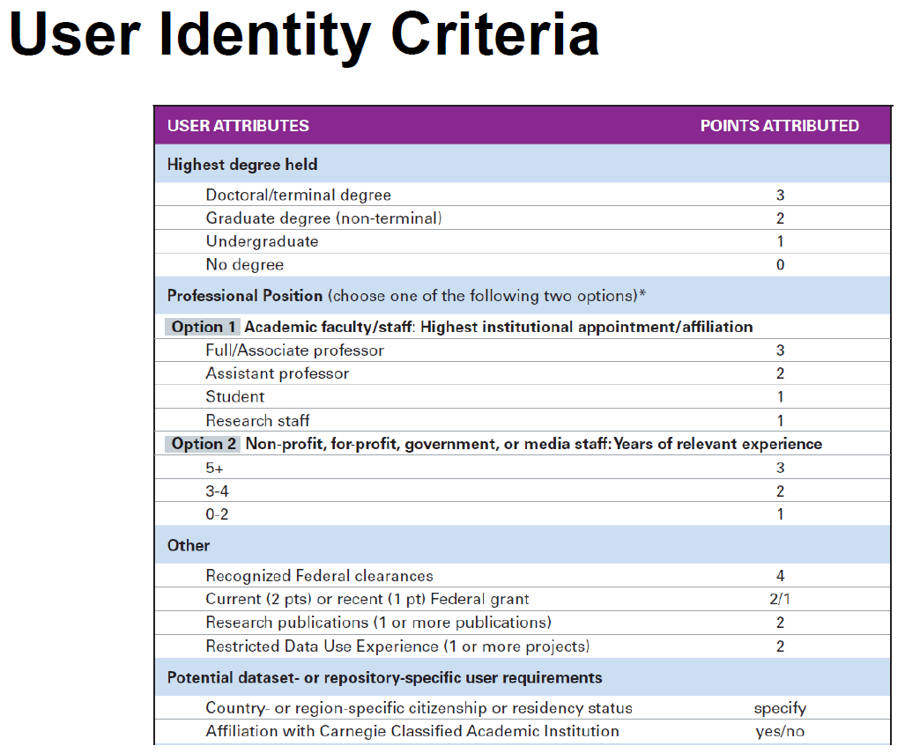

Slide 44
Data Security Levels
Low
No identifiable information (generally public-access)
Moderate
Not fully anonymized, non-trivial risk
High
Not anonymized though without direct identifiers
Highest
Includes direct identifiers, require special handling

Slide 45
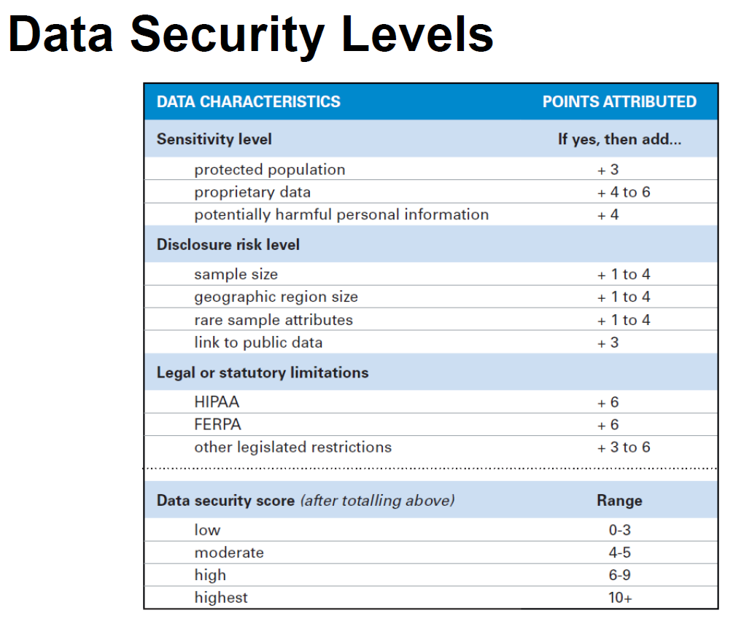

Slide 47
Visas
Connecting credential holders to the data sets and access methods they are authorized for
Record of prior use
Visa controls access to secure download or VDE
Visa issued after signed DUA

Slide 48
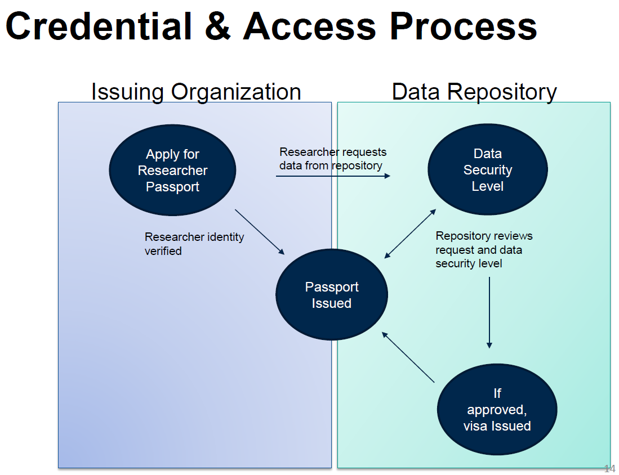

Slide 49
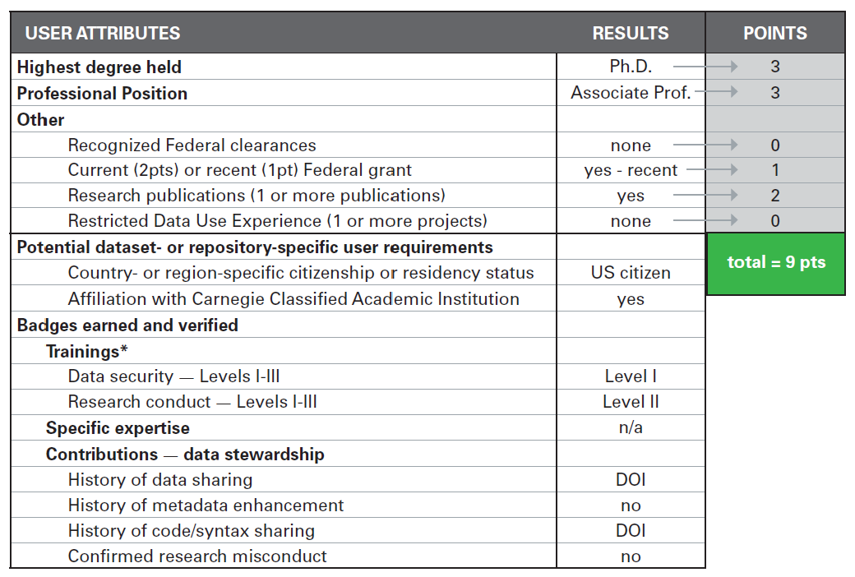

Slide 50
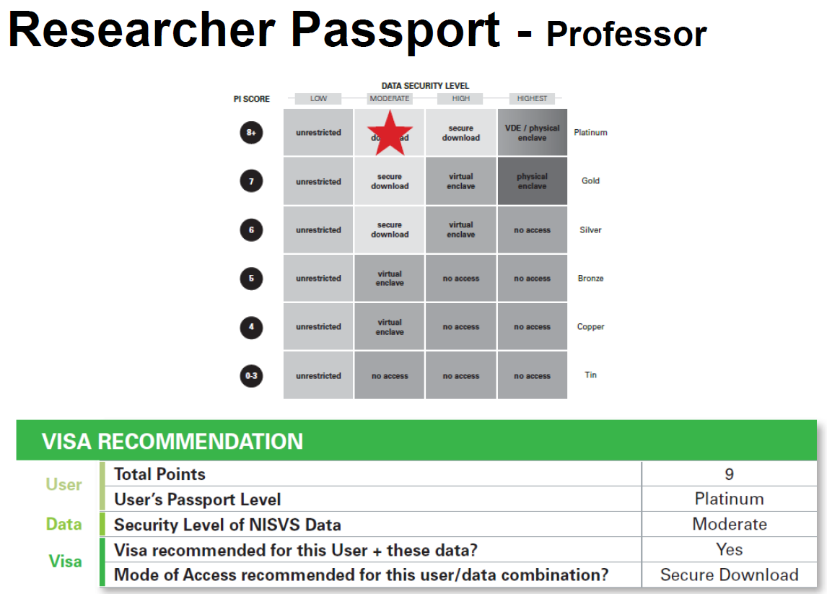

Slide 51
Next Steps
Build and test credentialing system and interface
Evaluate restricted data management training programs
Collaborate with restricted data community partners

Slide 53
Building Communities through Commenting and Contributing
Notes:
The Bibliography now references nearly 70,000 works, including journal articles, books, working papers, dissertations, and newspaper articles.

Slide 54
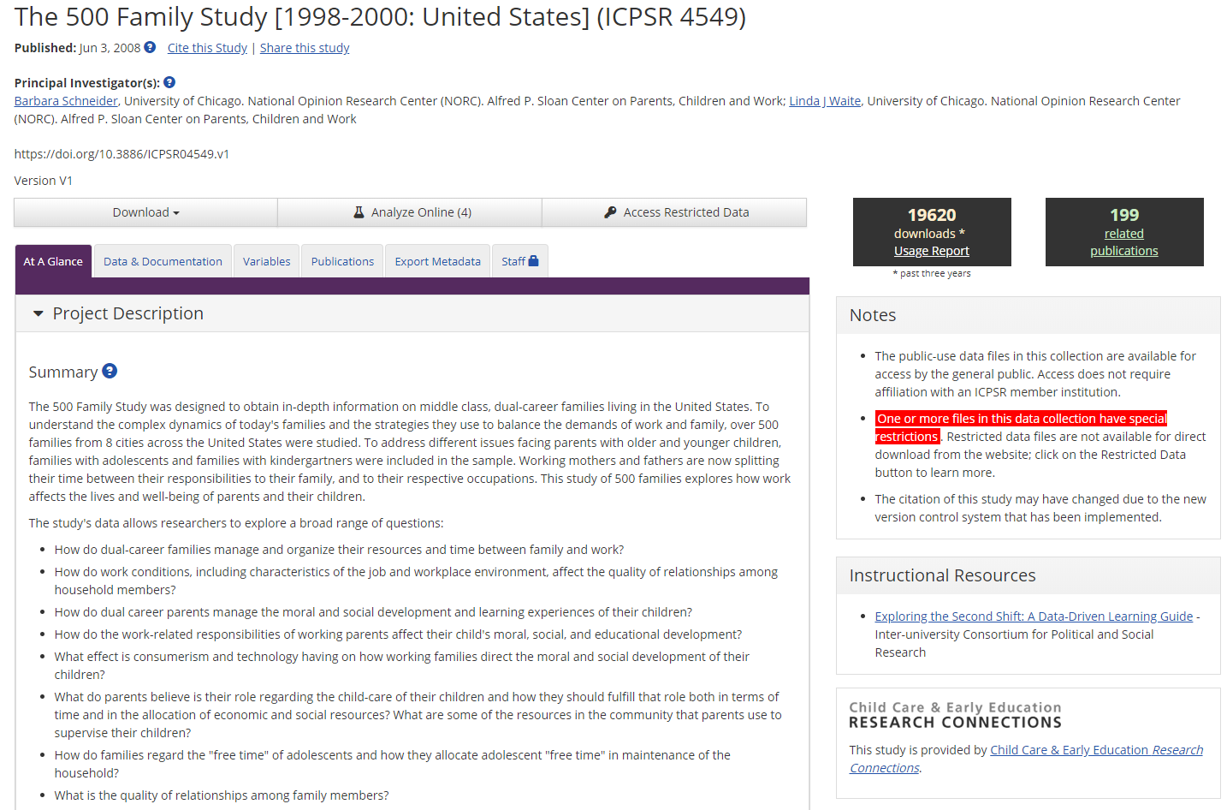

Slide 56
ICPSR Project Team
Susan Hautaniemi Leonard
Abay Israel
Maggie Levenstein
Trent Alexander
In collaboration with Texas A&M University
Funded by the National Science Foundation
Notes:
Texas A&M computer scientists and social scientists
NSF EAGER funding
LinkageLibrary will be open to the public and the research community, and you can be a part

Slide 57
Data linkage challenges
Linked data present challenges for both confidentiality and reproducibility
Linkage more accurate with more detailed information
Need standards for safe, ethical ways to enhance data with new linkages
Linked data easier to re-identify, even after removing unique identifiers
Need safe places to analyze linked data
Linkage strategies introduce differences in datasets that are often not well documented

Slide 58
Encourage researchers to share linked (or linkable) data, and linkage strategies
Algorithms, code
Compare approaches across projects, datasets, disciplines
Improve linkage practices
Improve transparency
Coming this fall
Looking for beta testers now!

Slide 59
Our goals:
Accelerate development of new record linkage and evaluation methods, and use on real data
Improve reproducibility of analyses
Develop critical collaborations between researchers, users, and data custodians
Help close the gap between research and practice
Train the next generation of multi-disciplinary data scientists who can lead the field.
Build cross-disciplinary community around data linkage
Notes:
Linked data have special challenges
Link quality – false positives and false negatives
Linkage-induced bias
Potentially increased disclosure risk
LOTS of work being done – we want to create a place where this work can go forward synergistically

Slide 60
Our approach:
Build a repository that is based on openICPSR
Seed it with a variety of exciting projects
Invite the research community to:
Visit the site
Download and use code and data
Create projects
Comment on existing projects
Contribute to existing projects
Notes:
LIFE-M – links all kinds of records about people to their birth record. Can follow women through their lifetime. Links generations together.
CensHRS - A Census-Enhanced Health and Retirement Study: A Proposal to Create and Analyze an HRS Dataset Enhanced with Characteristics of Employers Sloan foundation, (co-PIs, Matthew Shapiro, David Weir, John Abowd, and Kristen McCue)
IRIS – Institution for Research on Innovation in Science – Data repository linking research funding to economic impacts
Sunshine List - Canadian public sector employee salaries
CARRA – for testing linking methodologies

Slide 61
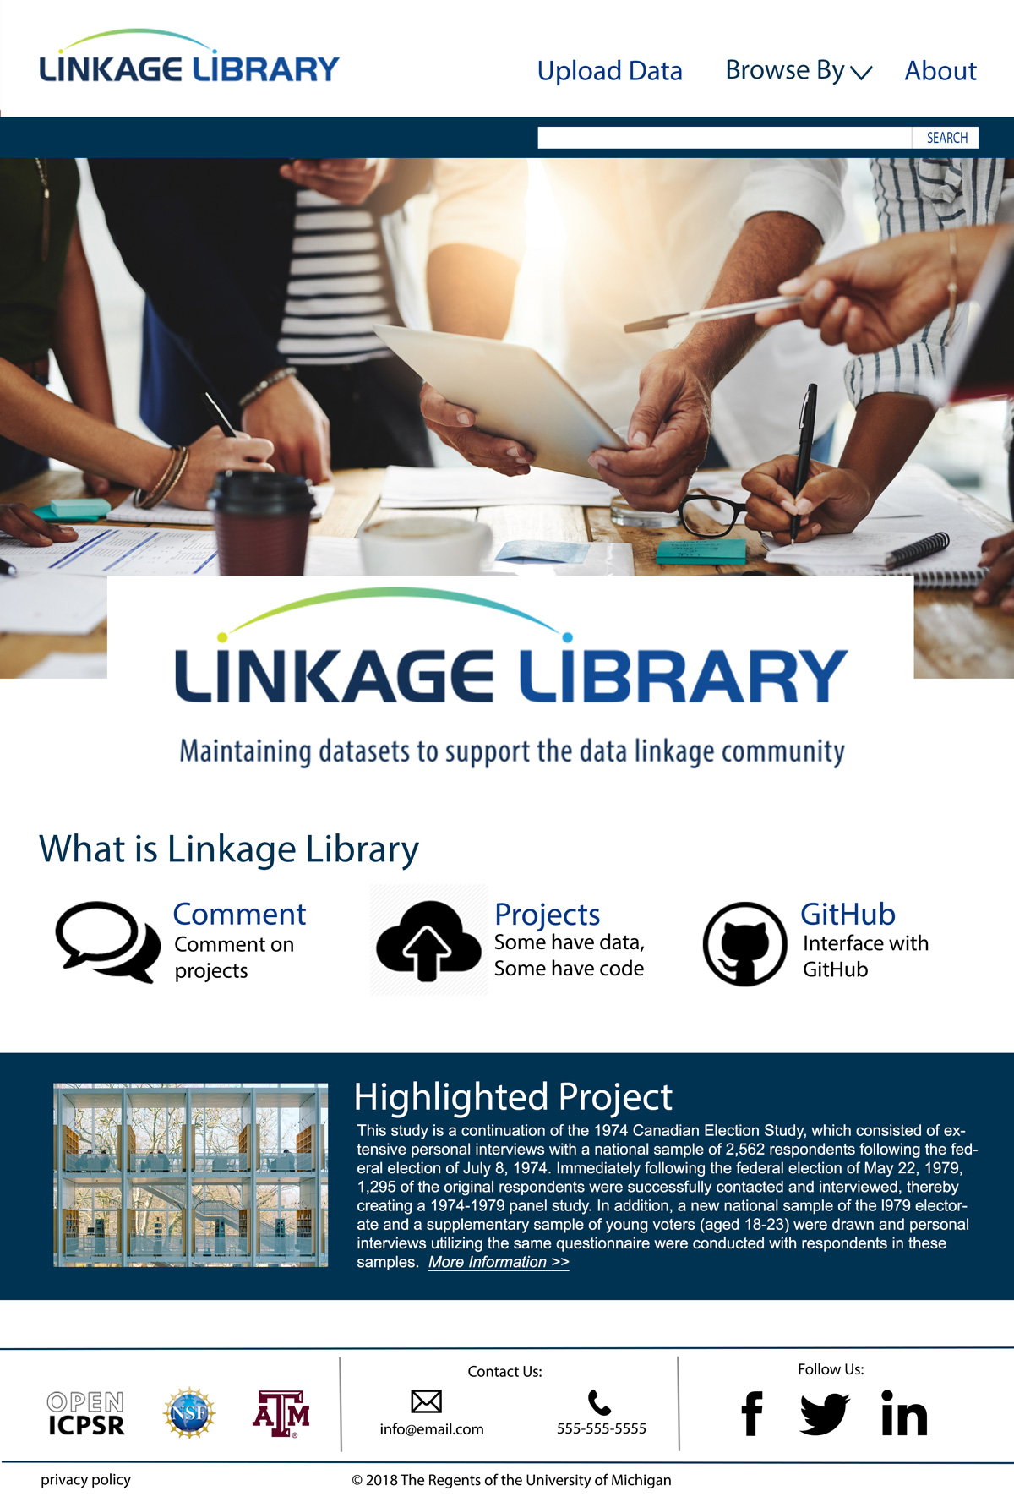

Slide 62
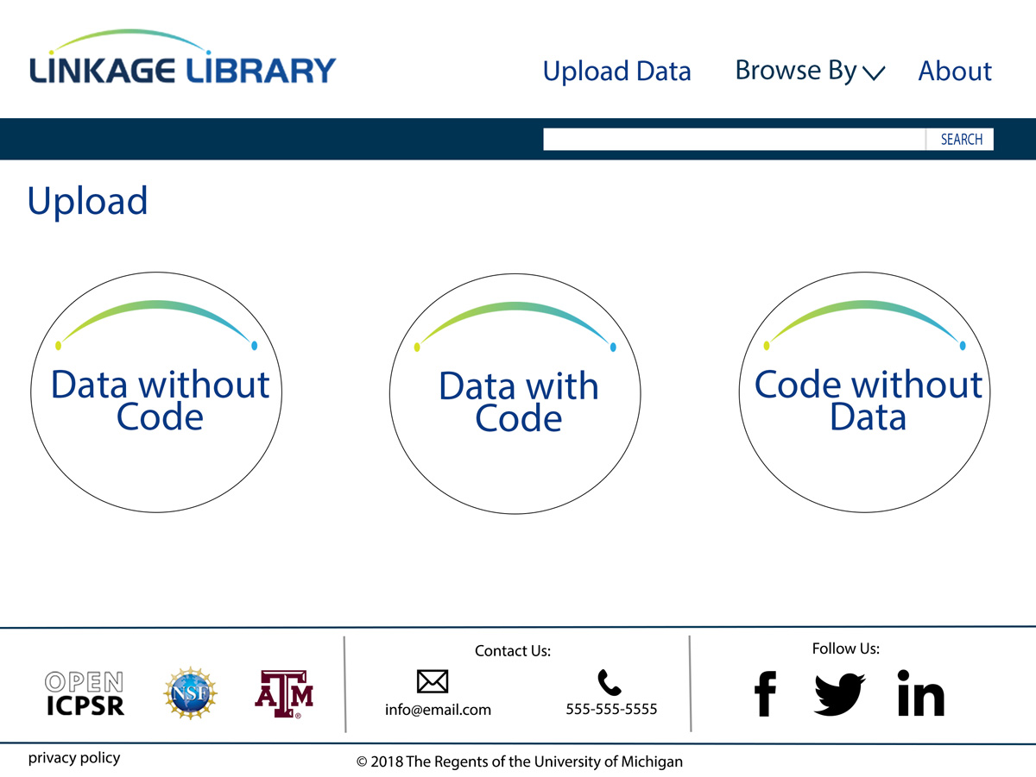

Slide 63
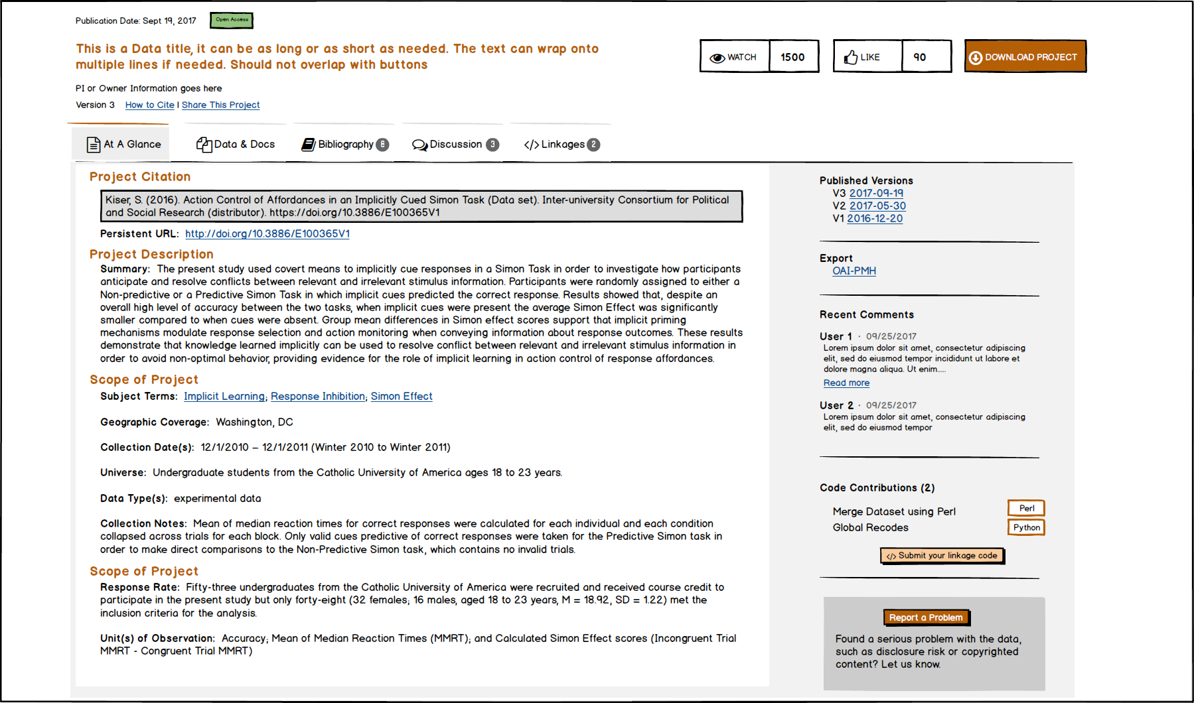
Notes:
Discussion – really excited about that – get researchers talking to others in the same research space

Slide 64
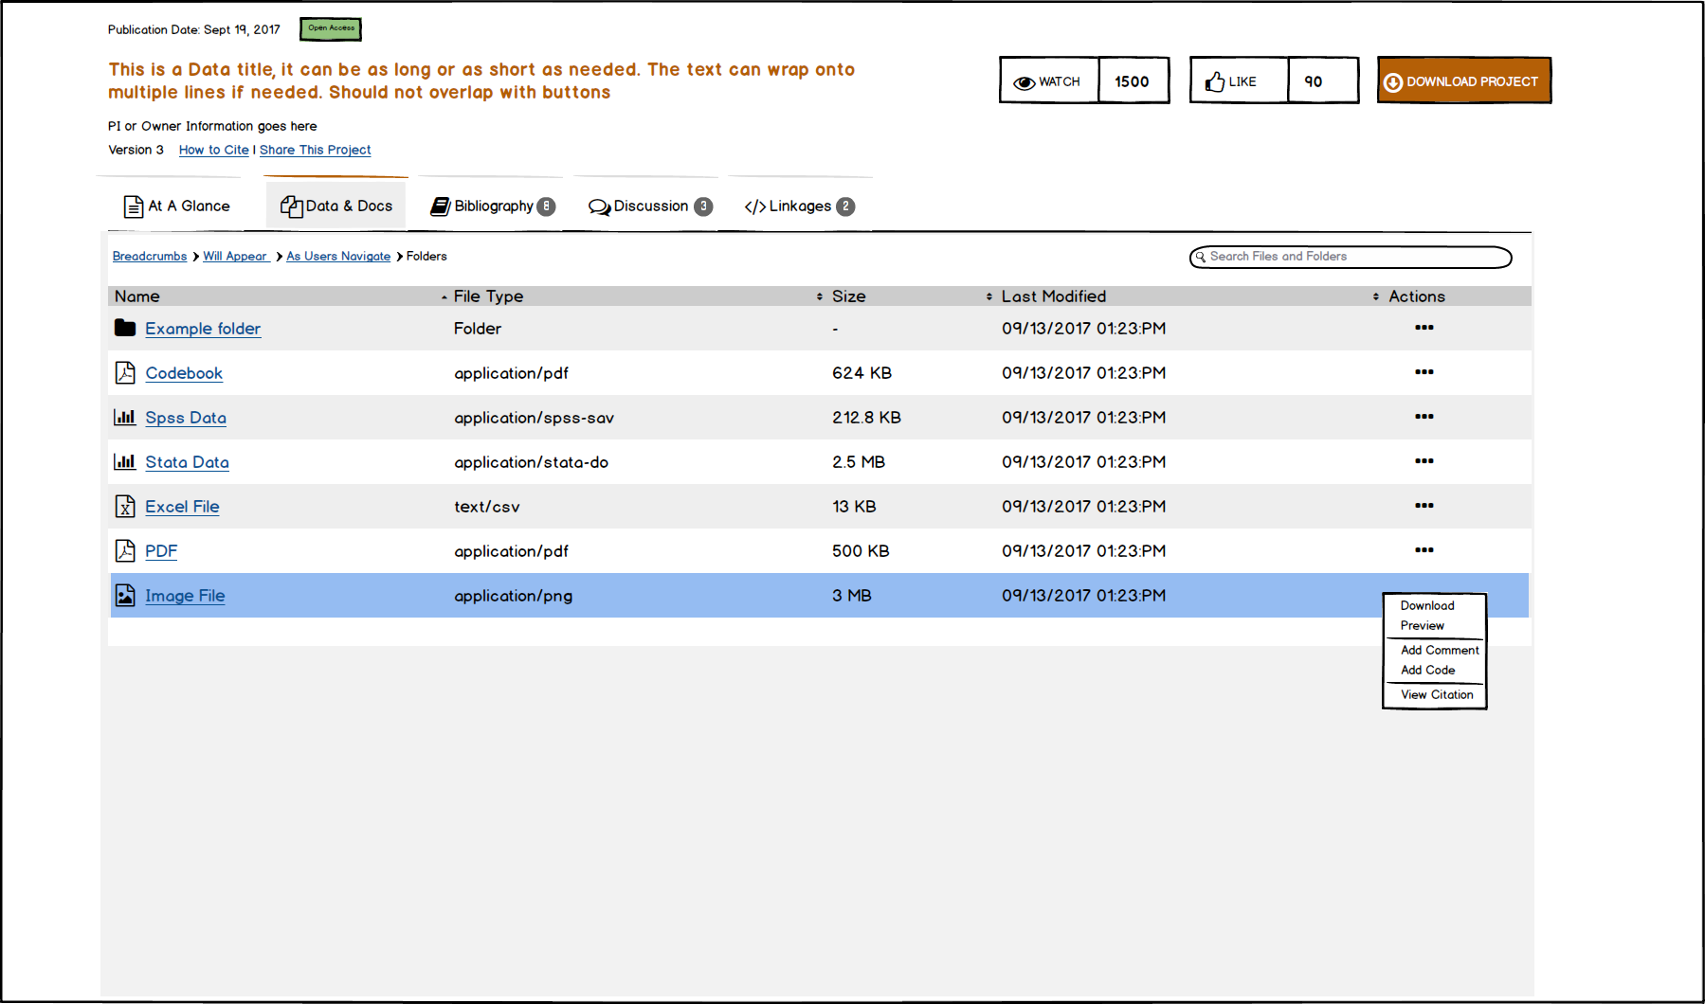
Notes:
Any type of file, download preview, etc. If data are not public access, a message is displayed directing user how to request access to restricted data through ICPSR.

Slide 65
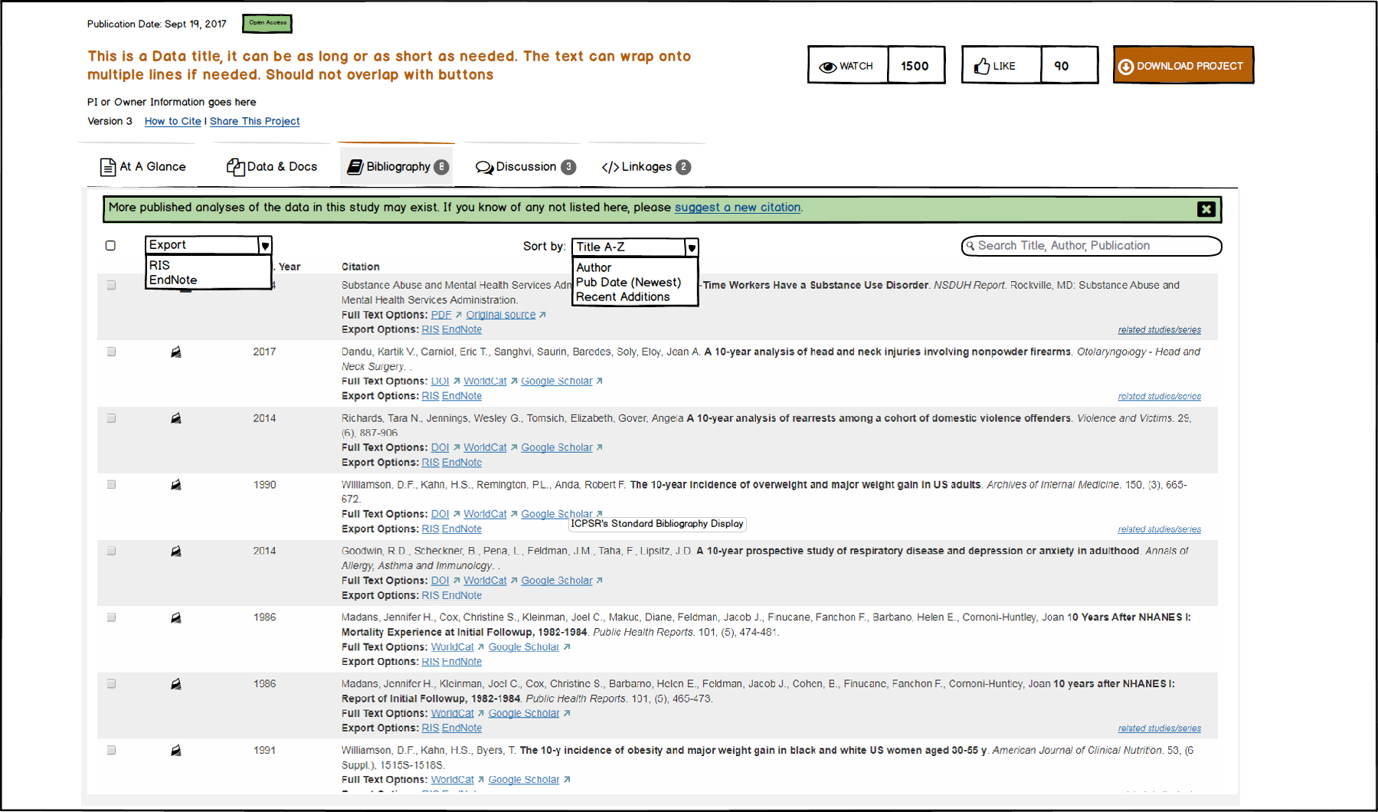

Slide 66
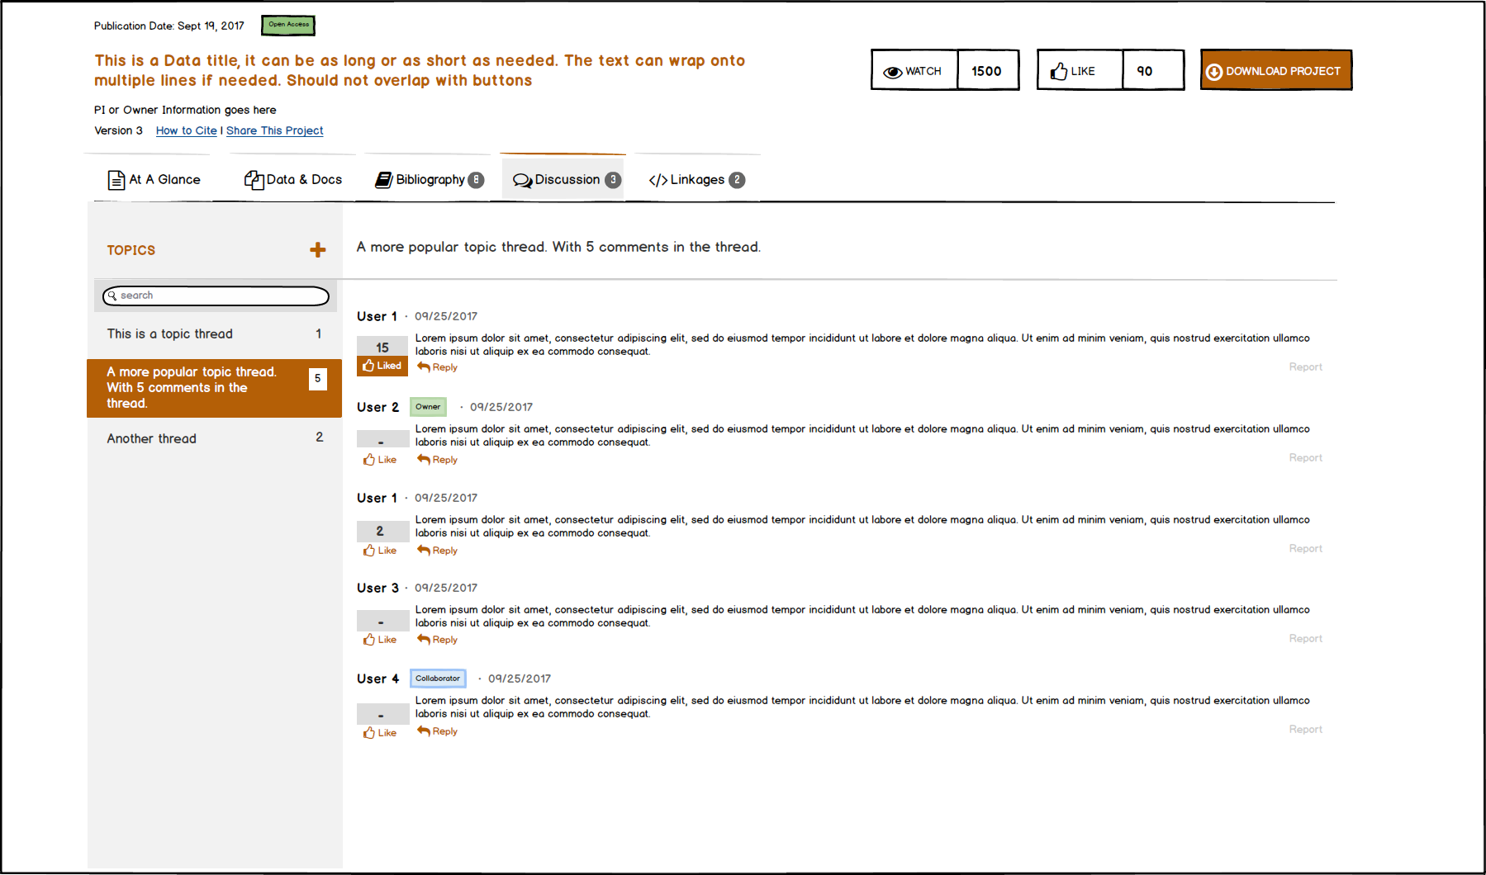

Slide 67
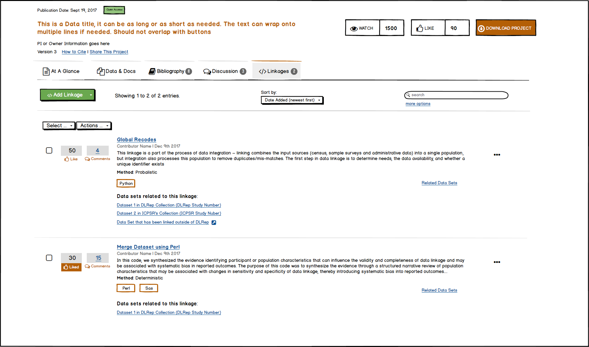

Slide 68
Questions
Can reach ICPSR at help@icpsr.umich.edu
Bibliography
Elizabeth Moss at eammoss@umich.edu
Researcher Credentialing
Johanna Bleckman at bleckman@umich.edu
LinkageLibrary
Susan Leonard at hautanie@umich.edu
The initiatives described here are supported by the National Science Foundation (1744065) and the Sloan Foundation.

Slide 70


Three types of projects
Data & Code
Data Only
Code Only
Notes:
Projects can have data, code, or both

Slide 71
Join us!
Lead and learn in a record linkage community
Full metadata for linked data and methodology
LinkageLibrary is looking for contributors and users
Soft launch expected by year’s end
Contact Susan Leonard at ICPSR for more information (hautanie@umich.edu)

Slide 72
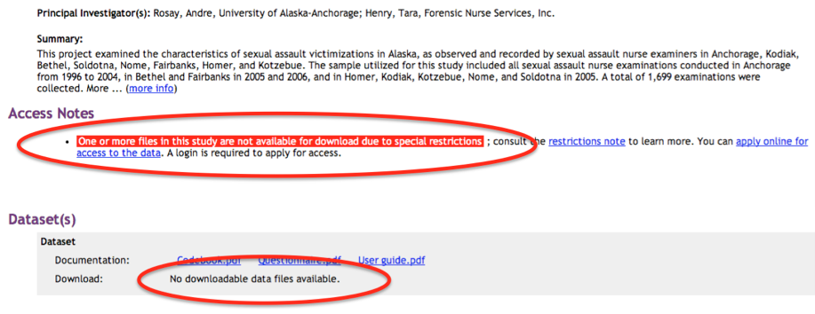

Slide 73
VDE Options and Software
ICPSR offers options such as
Vetting of research results generated in VDE
Third-party disclosure review with release of cleared output outside VDE firewall
File sharing among project team members
Software tools and support available for use within VDE include
Geospatial analysis tools
Statistical analysis software
Various documentation programs

Slide 74
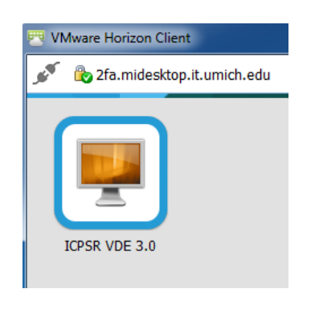
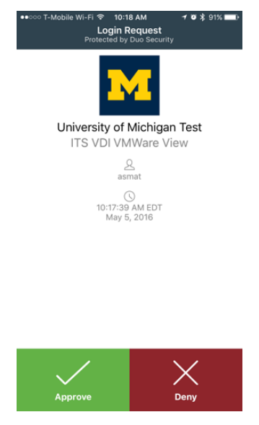
VMWare + Two-factor Authentication

Slide 75
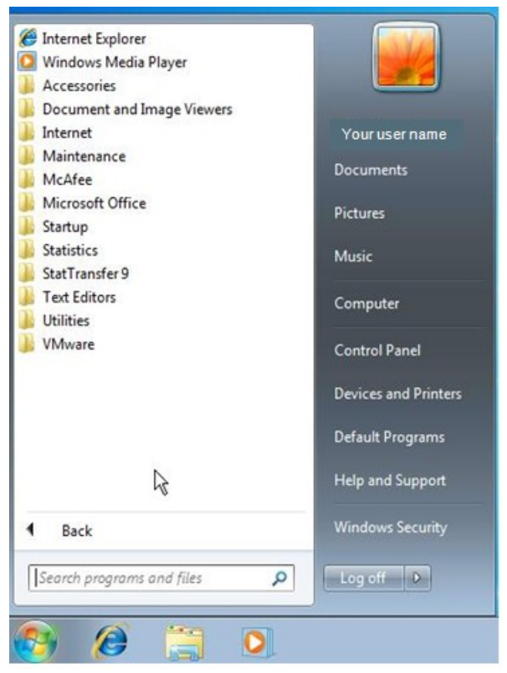
VDE Desktop
Notes:
The VDE operates just like a standard Windows desktop and includes many of the most popular statistical analysis packages. All work with the data files is done within the VDE. The data files and software never leave the ICPSR servers.

Slide 76
VDE Pricing Models
Per User
Access to VDE to analyze data for one year
Current annual access fee: $350 per user
Supports virtual machine technology and associated software licensing costs
Per Machine
Sponsor pays for certain number of virtual machines that are reserved for particular data sets or research community
Each virtual machine can support one simultaneous user

Slide 77
Credentialing Project Research Methodology
Environmental scan and organizational study of 23 restricted data repositories
16 United States
7 International (Germany, Australia, United Kingdom, the Netherlands)
Document analysis
Policy documents, legal statutes, repository documentation
Interviews
Semi-structured interviews with repository staff

Slide 78
Convening of Stakeholders
July 24, 2017: ICPSR and Georgetown convened over two dozen representatives from government agencies, data repositories, and academic institutions
Researcher Attributes/Research Identity: Professional and institutional affiliations, training certifications, grants received, and publication history
Feedback from meeting informs White Paper to be published this winter
Developing and testing software and web interface of credentialing system

Slide 79
On-line passport application Verified identification

Slide 80
Professional qualifications and affiliations

Slide 81
History of data stewardship

Slide 82
Participating repository issue visas
Note that this is conceptual. These repositories have not agreed to this!

Slide 83
In 2014, researchers and data repository managers were asked:
“How interested would you be to know each of the following about the impact of your data?
*White dots show the mean on a scale of one-to-four. All error bars depict 95% confidence intervals calculated by basic bootstrap with 10,000 resamplings.
J Kratz and C Strasser. 2015. Making data count. Nature Scientific Data 2: 150039. dx.doi.org/10.1038/sdata.2015.39
Notes:
Everyone values data citations (depositors, users, funders)
Downloads: Download counts, on the other hand, are both highly valuable and practical to collect. Downloads were a resounding second-choice metric for researchers and 85% of repositories already track them.
Citations: Citations are the coin of the academic realm. They were by far the most interesting metric to both researchers and data managers. Unfortunately, citations are much more difficult than download counts to work with, and relatively few repositories track them. Beyond technical complexity, the biggest challenge is cultural: data citation practices are inconsistent at best, and formal data citation is rare. Despite the difficulty, the value of citations is too high to ignore, even in the short term.
https://datapub.cdlib.org/2015/08/04/2334/

Slide 84
Researcher passport
Implementation plan
Issue passports as digital identifiers associated with ICPSR MyData Accounts
Open badges
Portable, Verifiable, Transparent, Flexible
Repositories issue visas to access restricted data
Visa controls access to secure download or VDE
Visa issued after signed DUA
Establishing content of training requirements
Determining which existing training include that content
Governance system to provide due process for allegations of misconduct

Slide 85
LinkageLibrary entrance

Slide 86
More about linkage strategy

Slide 87
Share data, documents, code

Slide 88
Share ideas

Slide 89
Protect data and files

Slide 90
Threaded discussion

Slide 91
Linkage algorithms

Slide 92
Related data & documents

Slide 93
Seeding the LinkageLibrary
Bailey et al. LIFE-M project
Levenstein et al. CensHRS project
Jason Owen-Smith et al. IRIS project
Antonie et al. Sunshine List
Access to CARRA Census Bureau benchmark files
Notes:
LIFE-M – links all kinds of records about people to their birth record. Can follow women through their lifetime. Links generations together.
CensHRS - A Census-Enhanced Health and Retirement Study: A Proposal to Create and Analyze an HRS Dataset Enhanced with Characteristics of Employers Sloan foundation, (co-PIs, Matthew Shapiro, David Weir, John Abowd, and Kristen McCue)
IRIS – Institution for Research on Innovation in Science – Data repository linking research funding to economic impacts
Sunshine List - Canadian public sector employee salaries
CARRA – for testing linking methodologies

Slide 94
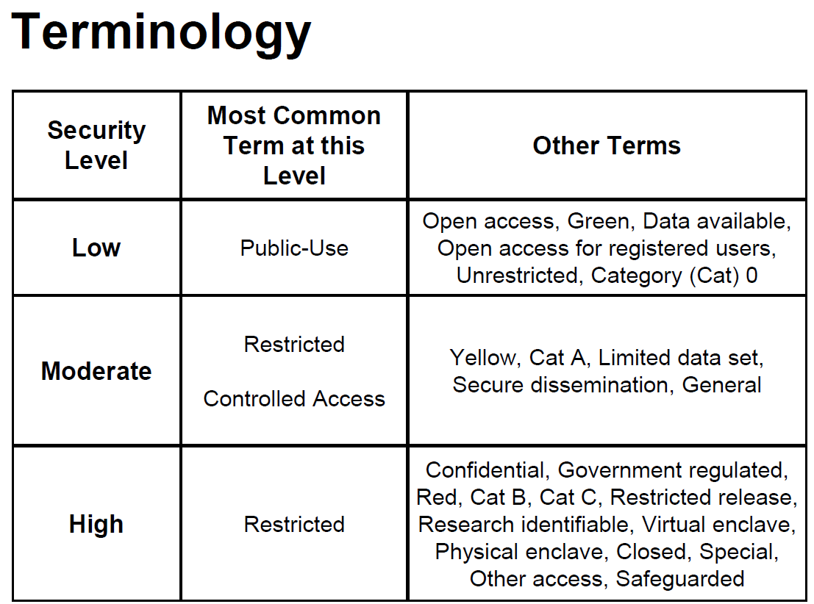
Notes:
Which leads to: Unwillingness of repositories and data custodians to accept identity verification by other institutions

